Slide 1
L0: Introduction to the Subject Discrete Mathematics
By
Prof. M.B. Narnaware
(Assistant Prof. @IT-WCE)

Slide 2
Today’s Agenda
Discussion on Syllabus
About Tutorials
About MSE & ESE
About ISE
Why to study Discrete Mathematics.

Slide 3
Syllabus

Slide 4
About Tutorials
Tutorials are very important.
High weightage to Tutorial Questions in MSE & ESE.

Slide 5
About ISE
ISE-1A will be online objective exam.
ISE-1B will be on modelling some Discrete Mathematics object.
ISE-2A will be online objective exam.
ISE-2B will be PPT presentation on application of concept/s in Discrete Mathematics by the group of three students.

Slide 6
Why to study Discrete Mathematics.

Slide 7
Discrete vs. Continuous Mathematics
Continuous Mathematics
It considers objects that vary continuously;
Example: analog wristwatch (separate hour, minute, and second hands).
From an analog watch perspective, between 1 :25 p.m. and 1 :26 p.m.
there are infinitely many possible different times as the second hand moves
around the watch face.
Real-number system --- core of continuous mathematics;
Continuous mathematics --- models and tools for analyzing real-world
phenomena that change smoothly over time. (Differential equations etc.)

Slide 8
Discrete vs. Continuous Mathematics
Discrete Mathematics
It considers objects that vary in a discrete way.
Example: digital wristwatch.
On a digital watch, there are only finitely many possible different times
between 1 :25 P.M. and 1:27 P.M. A digital watch does not show split
seconds: - no time between 1 :25:03 and 1 :25:04. The watch moves from one
time to the next.
Integers --- core of discrete mathematics
Discrete mathematics --- models and tools for analyzing real-world
phenomena that change discretely over time and therefore ideal for studying
computer science – computers are digital! (numbers as finite bit strings; data structures, all discrete!)

Slide 9
What is computer science? (examples)

Slide 10
Why Discrete Mathematics? (I)
Computers use discrete structures to represent and manipulate data.
The subject Discrete Mathematics is the most fundamental subject for becoming a Computer Scientist.
Computer Science is not Programming.
Computer Science is about problem solving.

Slide 11
Why Discrete Mathematics? (II)
Mathematics is at the heart of problem solving
Defining a problem requires mathematical rigor
Use and analysis of models, data structures, algorithms requires a solid foundation of mathematics
To justify why a particular way of solving a problem is correct or efficient (i.e., better than another way) requires analysis with a well-defined mathematical model.

Slide 12
Problem Solving requires mathematical rigor
Your boss is not going to ask you to solve
an MST (Minimal Spanning Tree) or
a TSP (Travelling Salesperson Problem)
Rarely will you encounter a problem in an abstract setting
However, he/she may ask you to build a rotation of the company’s delivery trucks to minimize fuel usage
It is up to you to determine
a proper model for representing the problem and
a correct or efficient algorithm for solving it

Slide 13
What’s your job?
Build a mathematical model for each scenario
Develop an algorithm for solving each task
Justify that your solutions work
Prove that your algorithms terminate. Termination
Prove that your algorithms find a solution when there is one. Completeness
Prove that the solution of your algorithms is correct Soundness
Prove that your algorithms find the best solution (i.e., maximize profit). Optimality (of the solution)
Prove that your algorithms finish before the end of life on earth. Efficiency, time & space complexity

Slide 14
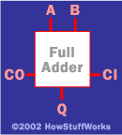
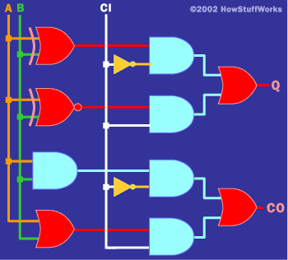
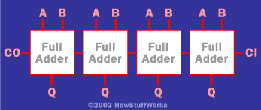
Logic: Hardware and software specifications
Formal: Input_wire_A
value in {0, 1}
One-bit Full Adder with
Carry-In and Carry-Out
Example 1: Adder
4-bit full adder
Example 2: System Specification:
The router can send packets to the edge system only if it supports the new address space.
For the router to support the new address space it’s necessary that the latest software release be installed.
The router can send packets to the edge system if the latest software release is installed.
The router does not support the new address space.
How to write these specifications in a rigorous / formal way? Use Logic.

Slide 15
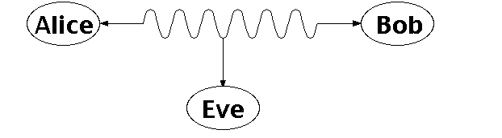
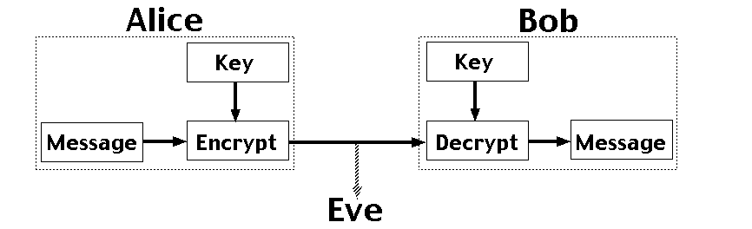
Number Theory: RSA and Public-key Cryptography
Alice and Bob have never met but they would like to
exchange a message. Eve would like to eavesdrop.
E.g. between you and the Bank of America.
They could come up with a good encryption algorithm and exchange the encryption key – but how to do it without
Eve getting it? (If Eve gets it, all security
is lost.)
CS folks found the solution:
public key encryption. Quite remarkable
that that is feasible.
Notes:
One solution is for Alice and Bob to exchange a digital key, so they both know it, but it's otherwise secret. Alice uses this key to encrypt messages she sends, and Bob reconstructs the original messages by decrypting with the same key. The encrypted messages (ciphertexts) are useless to Eve, who doesn't know the key, and so can't reconstruct the original messages. With a good encryption algorithm, this scheme can work well, but exchanging the key while keeping it secret from Eve is a problem. This really requires a face to face meeting, which is not always practical.

Slide 16
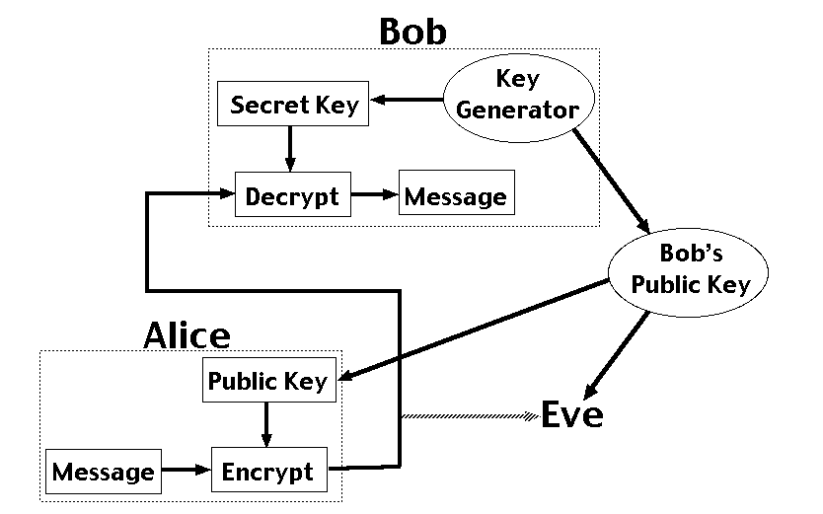
Number Theory: Public Key Encryption
RSA – Public Key Cryptosystem (why RSA?)
Uses modular arithmetic and large primes → Its security comes from the computational difficulty
of factoring large numbers.
Notes:
Public key encryption is different, because it splits the key up into a public key for encryption and a secret key for decrpytion. It's not possible to determine the secret key from the public key. In the diagram, Bob generates a pair of keys and tells everybody (including Eve) his public key, while only he knows his secret key. Anyone can use Bob's public key to send him an encrypted message, but only Bob knows the secret key to decrypt it. This scheme allows Alice and Bob to communicate in secret without having to meet.
RSA rivest, shamir and adleman

Slide 17
Graphs and Networks
Many problems can be represented by a graphical network representation.
Examples:
Distribution problems
Routing problems
Maximum flow problems
Designing computer / phone / road networks
Equipment replacement
And of course the Internet
Aside: finding the right
problem representation
is one of the key issues.

Slide 18
Applications of Networks
Applications
Physical analog of nodes
Physical analog of arcs
Flow
Communication systems
phone exchanges,
computers,
transmission
facilities, satellites
Cables, fiber optic
links, microwave
relay links
Voice messages, Data, Video transmissions
Hydraulic systems
Pumping stations Reservoirs, Lakes
Pipelines
Water, Gas, Oil, Hydraulic fluids
Integrated computer circuits
Gates, registers, processors
Wires
Electrical current
Mechanical systems
Joints
Rods, Beams, Springs
Heat, Energy
Transportation systems
Intersections, Airports, Rail yards
Highways, Airline routes Railbeds
Passengers,
freight,
vehicles,
operators

Slide 19
Goals of 3IT202
Introduce students to a range of mathematical tools from discrete mathematics that are key in computer science
Mathematical Sophistication
How to write statements rigorously
How to read and write theorems, lemmas, etc.
How to write rigorous proofs
Areas we will cover:
Logic and proofs
Set Theory
Induction and Recursion
Counting and combinatorics
Graph Theory & Boolean Algebra
Number Theory (if time permits)
Practice works!
Actually, only practice works!
Note: Learning to do proofs from
watching the slides is like trying to
learn to play tennis from watching
it on TV! So, do the exercises!

Slide 20
We will try to solve the problems from:
GATE Exam.
CMI Exam for Computer Scientist.
JEST Exam.

Slide 21
Welcome to the course Discrete Mathematics.
Let us make the course:
Concept oriented.
Informative.
Enjoyable.
But NOT EXAM ORIENTED.

